Slide 1
Unit 4. Memory Management

Slide 2
Introduction to Memory Management
One of the main tasks of an operating system is to manage the computer’s memory. This includes many responsibilities, for example:
1. Being aware of what parts of the memory are in use and which parts are not.
2. Allocating memory to processes when they request it and de-allocating memory when a process releases its memory.
3. Moving data from memory to disc, when the capacity of physical memory becomes full, and vice versa.
4. Managing hierarchical memory
e.g. volatile cache -> RAM ->Disk storage.

Slide 3
Logical and Physical Address
In operating systems, logical and physical addresses are used to manage and access memory.
Logical address:
A logical address, also known as a virtual address, is an address generated by the CPU during program execution.
It is the address seen by the process and is relative to the program’s address space.
The process accesses memory using logical addresses, which are translated by the operating system into physical addresses.
Physical address:
A physical address is the actual address in main memory where data is stored.
It is a location in physical memory, as opposed to a virtual address.
Physical addresses are used by the memory management unit (MMU) to translate logical addresses into physical addresses.

Slide 4
Mono-programming without Swapping
The simplest possible memory management scheme is to run just one program at a time, sharing the memory between that program and the operating system.
Three variations on this theme are shown in Fig.1.
The operating system may be at the bottom of memory in RAM (Random Access Memory), as shown in Fig. 1(a), or it may be in ROM (Read-Only Memory) at the top of memory, as shown in Fig. 1(b), or the device drivers may be at the top of memory in a ROM and the rest of the system in RAM down below, as shown in Fig. 1(c).

Slide 5
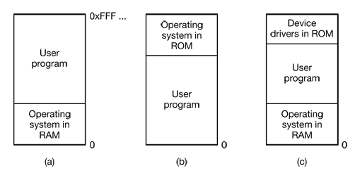
Figure 1. Three simple ways of organizing memory with an operating system and one user process.
When the system is organized in this way, only one process at a time can be running

Slide 6
Multiprogramming with Fixed Partitions
Most modern systems allow multiple processes to run at the same time.
Having multiple processes running at once means that when one process is blocked waiting for I/O to finish, another one can use the CPU. Thus multiprogramming increases the CPU utilization.
The easiest way to achieve multiprogramming is simply to divide memory into n (possibly unequal) partitions.
When a job arrives, it can be put into the input queue for the smallest partition large enough to hold it.
Since the partitions are fixed in this scheme, any space in a partition not used by a job is lost.

Slide 7
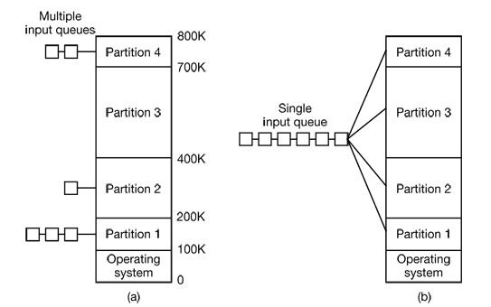
Figure 2. (a) Fixed memory partitions with separate input queues for each partition. (b) Fixed memory partitions with a single input queue

Slide 8
Multiprogramming with Variable Partitions
Fixed partitions can be wasteful of memory.
Therefore it would be a good idea to move towards variable partition sizes. That is partitions that can change size as the need arises.
Variable partitions can be summed up as follows:
The number of partition varies.
The sizes of the partitions varies
The starting addresses of the partitions varies.

Slide 9
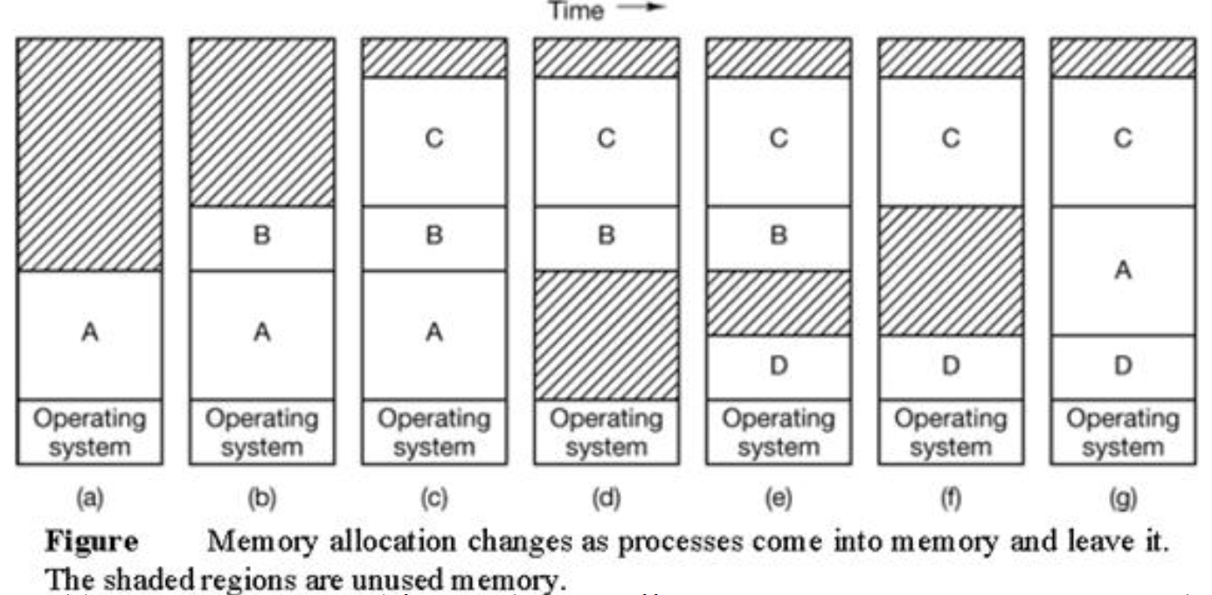

Slide 10
Memory Management with Bitmaps
When memory is assigned dynamically, the operating system must manage it.
In general terms, there are two ways to keep track of memory usage: bitmaps and link lists.
With a bitmap, memory is divided up into allocation units.
Corresponding to each allocation unit is a bitwhich is 0 if the unit is free and 1 if it is occupied (or vice versa). in the bitmap,
Figure below shows part of memory and the corresponding bitmap.

Slide 11
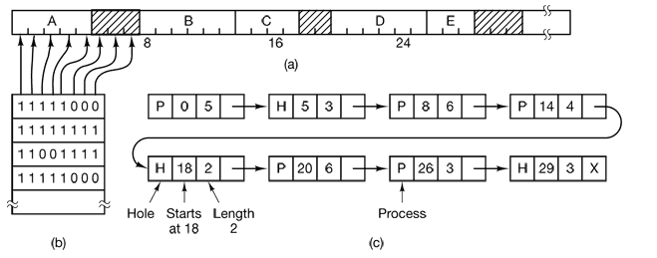
Figure: (a) A part of memory with five processes and three holes. The tick marks show the memory allocation units. The shaded regions (0 in the bitmap) are free. (b) The corresponding bitmap. (c) The same information in linked list.

Slide 12
Memory Management with Linked Lists
Another way of keeping track of memory is to maintain a linked list of allocated and free memory segments, where a segment is either a process or a hole between two processes.
Figure is represented in Fig. (c) as a linked list of segments.
Each entry in the list specifies a hole (H) or process (P), the address at which it starts, the length, and a pointer to the next entry

Slide 13
Memory Allocation Strategies
In operating systems, memory allocation refers to the process of assigning memory to different processes or programs running on a computer system.
There are two types of memory allocation techniques that operating systems use contiguous and non-contiguous memory allocation.
In contiguous memory allocation, memory is assigned to a process in a contiguous block.
In non-contiguous memory allocation, memory is assigned to a process in non-adjacent blocks.

Slide 14
Contiguous Memory Allocation
Contiguous memory allocation is a technique where the operating system allocates a contiguous block of memory to a process.
This memory is allocated in a single, continuous chunk, making it easy for the operating system to manage and for the process to access the memory.
Contiguous memory allocation can be done in two ways
Fixed Partitioning: the memory is divided into fixed-size partitions, and each partition is assigned to a process. This technique is easy to implement but can result in wasted memory if a process does not fit perfectly into a partition.
Dynamic Partitioning: the memory is divided into variable size partitions, and each partition is assigned to a process. This technique is more efficient as it allows the allocation of only the required memory to the process, but it requires more overhead to keep track of the available memory.

Slide 15
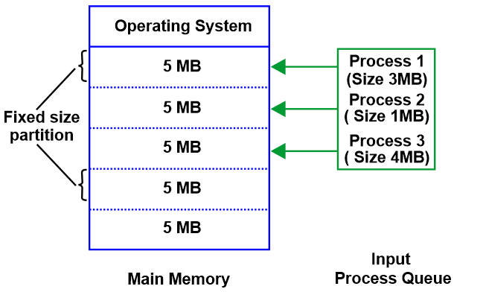

Slide 16
Contiguous Memory Allocation Strategies
First Fit: This algorithm searches along the list looking for the first segment that is large enough to accommodate the process. The segment is then split into a hole and a process. This method is fast as the first available hole that is large enough to accommodate the process is used.
Best Fit: Best fit searches the entire list and uses the smallest hole that is large enough to accommodate the process. The idea is that it is better not to split up a larger hole that might be needed later. Best fit is slower than first fit as it must search the entire list every time. It has also be shown that best fit performs worse than first fit as it tends to leave lots of small gaps.
Worst Fit: As best fit leaves many small, useless holes it might be a good idea to always use the largest hole available. The idea is that splitting a large hole into two will leave a large enough hole to be useful. It has been shown that this algorithm is not very good either.

Slide 17
Example:
Best fit: For example, suppose a process requests 12KB of memory and the memory manager currently has a list of unallocated blocks of 6KB, 14KB, 19KB, 11KB, and 13KB blocks. The best-fit strategy will allocate 12KB of the 13KB block to the process.
Worst fit: Using the same example as above, worst fit will allocate 12KB of the 19KB block to the process, leaving a 7KB block for future use.
First fit: Using the same example as above, first fit will allocate 12KB of the 14KB block to the process.

Slide 18
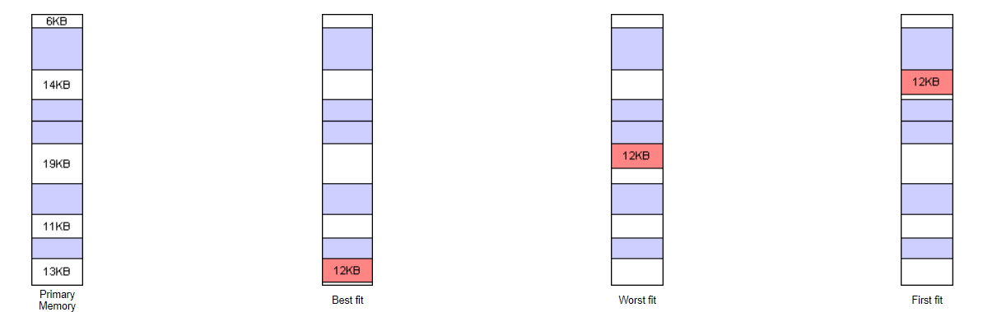

Slide 19
Non-contiguous Memory Allocation
Non-contiguous memory allocation, on the other hand, is a technique where the operating system allocates memory to a process in non-contiguous blocks.
The blocks of memory allocated to the process need not be contiguous, and the operating system keeps track of the various blocks allocated to the process.
Non-contiguous memory allocation can be done in two ways
Paging
Segmentation

Slide 20
Virtual Memory
Virtual memory is a memory management technique used by operating systems (OS) to provide an illusion of a larger main memory than what is physically available.
It allows programs to execute as if they have more memory than is actually installed on the computer.
In a computer system, physical memory refers to the actual RAM (Random Access Memory) chips installed in the system.
Virtual memory, on the other hand, is a layer of abstraction that sits between the programs running on the computer and the physical memory.

Slide 21
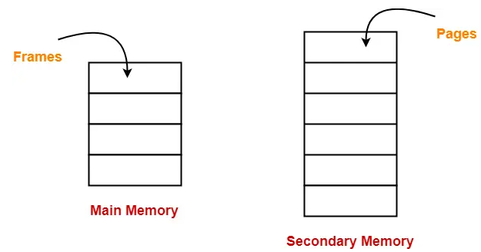
Paging
Paging is a memory management technique used by operating systems to implement virtual memory.
Paging is a fixed size partitioning scheme.
In paging, secondary memory and main memory are divided into equal fixed size partitions.
The partitions of secondary memory are called as pages.
The partitions of main memory are called as frames.
Each process is divided into parts where size of each part is same as page size.
The size of the last part may be less than the page size.
The pages of process are stored in the frames
of main memory depending upon their availability.

Slide 22
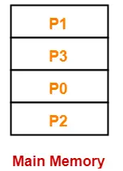
Consider a process is divided into 4 pages P₀, P₁, P₂ and P₃.
Depending upon the availability, these pages may be stored in the main memory frames in a non-contiguous fashion as shown-

Slide 23
Page Table
Page table is a data structure.
It maps the page number referenced by the CPU to the frame number where that page is stored.

Slide 24
Page fault
A page fault is an interruption that occurs when a software program attempts to access a memory block not currently stored in the system's RAM.
This exception tells the operating system to find the block in virtual memory so it can be sent from a device's storage (SSD or HD) to RAM.
Demand Paging
The Demand Paging is a condition which is occurred in the Virtual Memory.
The pages of the process are stored in secondary memory. The page is brought to the main memory when required.
The process of calling the pages to main memory to secondary memory upon demand is known as Demand Paging.

Slide 25
Page Replacement Algorithms
Page replacement is a process of swapping out an existing page from the frame of a main memory and replacing it with the required page.
Page replacement is required when-
All the frames of main memory are already occupied.
Thus, a page has to be replaced to create a room for the required page.
Page replacement algorithms help to decide which page must be swapped out from the main memory to create a room for the incoming page.
FIFO, LRU, Optimal and Second Chance are the examples of page replacement algorithm.

Slide 26
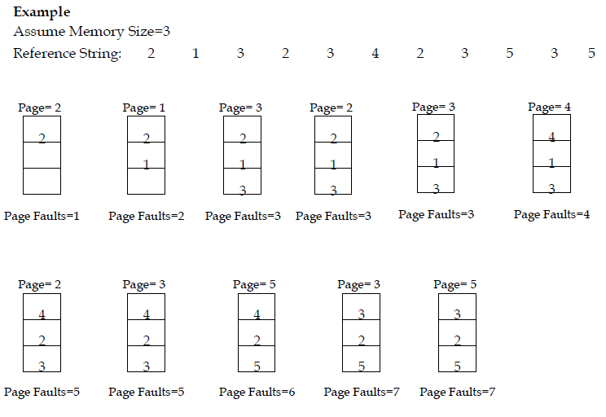
First-In First-Out (FIFO)

Slide 27
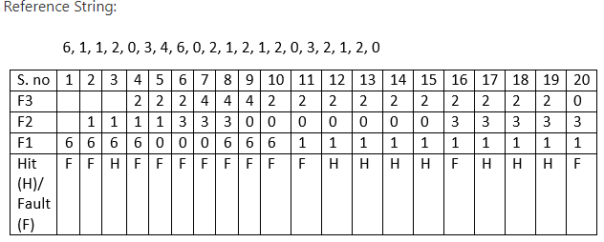
Consider the reference string 6, 1, 1, 2, 0, 3, 4, 6, 0, 2, 1, 2, 1, 2, 0, 3, 2, 1, 2, 0 for a memory with three frames and calculate number of page faults by using FIFO (First In First Out) Page replacement algorithms.
Number of Page Hits = 8
Number of Page Faults = 12
The Ratio of Page Hit to the Page Fault = 8 : 12 - - - > 2 : 3 - - - > 0.66
The Page Hit Percentage = 8 *100 / 20 = 40%
The Page Fault Percentage = 100 - Page Hit Percentage = 100 - 40 = 60%

Slide 28
Least Recently Used(LRU) Page Replacement Algorithm
Replace the page with the page which is less dimension of time recently used page in the past.
LRU replaces the page with the greatest backward distance in the reference string

Slide 29
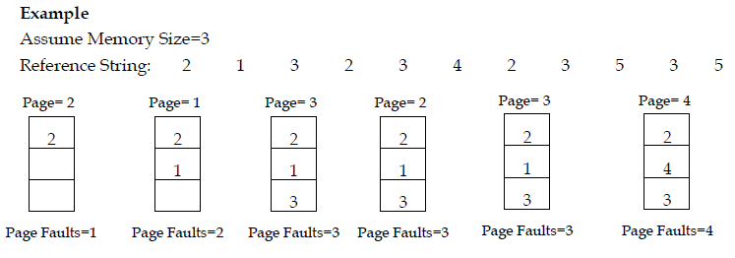
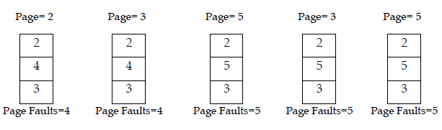

Slide 30
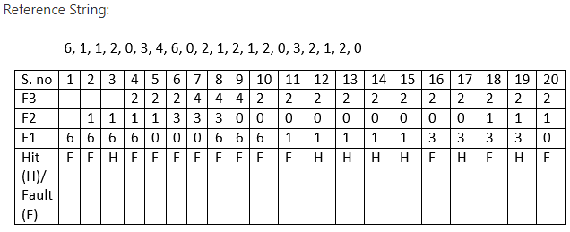
Consider the reference string 6, 1, 1, 2, 0, 3, 4, 6, 0, 2, 1, 2, 1, 2, 0, 3, 2, 1, 2, 0 for a memory with three frames and calculate number of page faults by using Least Recently Used (LRU) Page replacement algorithms.
Number of Page Hits = 7
Number of Page Faults = 13

Slide 31
OPTIMAL Page Replacement Algorithm
Replace the Page which is not used in the Longest Dimension of time in future.
This principle means that after all the frames are filled then, see the future pages which are to occupy the frames.
Go on checking for the pages which are already available in the frames. Choose the page which is at last.
Suppose the Reference String is:
0, 3, 4, 6, 0, 2, 1, 2, 1, 2, 0, 3, 2, 1, 2, 0
Suppose 6, 1, 2 are in the frames occupying the frames.
Now we need to enter 0 into the frame by removing one page from the page
So, let us check which page number occurs last
From the sub sequence 0, 3, 4, 6, 0, 2, 1 we can say that 1 is the last occurring page number.
So we can say that 0 can be placed in the frame body by removing 1 from the frame.

Slide 32
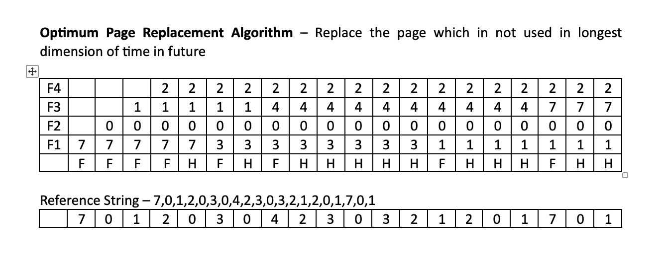

Slide 33
Consider the reference string 6, 1, 1, 2, 0, 3, 4, 6, 0, 2, 1, 2, 1, 2, 0, 3, 2, 1, 4, 0 for a memory with three frames and calculate number of page faults by using OPTIMAL Page replacement algorithms.

Slide 34

Second Chance Page Replacement Algorithm

Slide 35
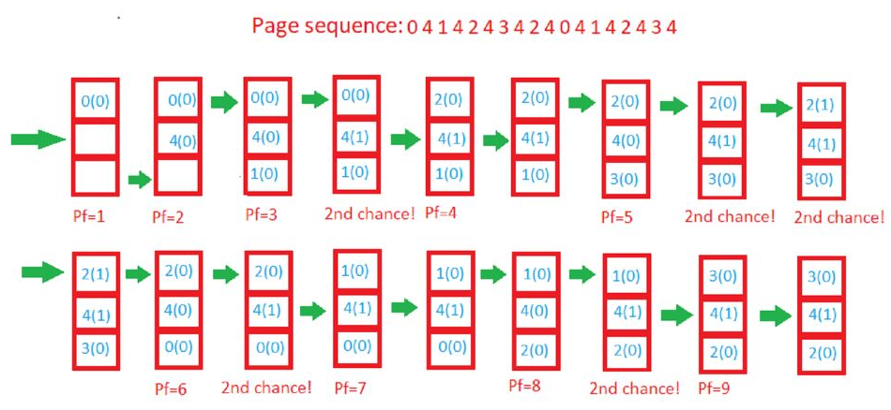

Slide 36
Thrashing in Operating Systems
Definition
Thrashing: A phenomenon in which a computer's performance deteriorates as a result of excessive paging or swapping, with the system spending more time moving data between main memory and secondary storage than executing instructions.
Causes
Insufficient Memory: When the available physical memory is not sufficient to accommodate the working set of active processes.
Overloaded System: Running too many processes concurrently, leading to increased demand for memory.
Inefficient Page Replacement: Poor page replacement algorithms can contribute to excessive swapping.

Slide 37
Characteristics
High Page Fault Rate: Frequent page faults as the system constantly retrieves data from secondary storage.
Low CPU Utilization: The CPU spends more time waiting for page transfers than executing actual processes.
Decreased Throughput: Overall system throughput decreases due to excessive paging activities.

Slide 38
Consequences
Poor System Response Time: Users experience delays in system responsiveness.
Degraded Performance: Overall system performance drops significantly.
Increased Overhead: Resources are consumed by excessive paging activities, reducing efficiency.

Slide 39
Mitigation Strategies
Optimize Page Replacement Algorithms: Choose efficient algorithms like LRU (Least Recently Used) to minimize unnecessary page swaps.
Increase Physical Memory: Upgrade hardware to provide more physical memory.
Tune System Parameters: Adjust system parameters to better balance the needs of processes and available resources.

Slide 40
Monitoring and Detection
Performance Metrics: Monitor page fault rates, CPU utilization, and disk activity to detect signs of thrashing.
System Logs: Analyze system logs for indications of excessive paging and swapping.

Slide 41
Segmentation
Segmentation is a memory management technique in which the memory is divided into the variable size parts.
Each part is known as a segment which can be allocated to a process.
The details about each segment are stored in a table called a segment table.
Segment table contains mainly two information about segment:
Base: It is the base address of the segment
Limit: It is the length of the segment.

Slide 42
Advantages
Modularity: Easier program development and maintenance due to separate logical units.
Protection: Each segment can have its own set of access rights, enhancing security.
Flexibility: Dynamic memory allocation allows efficient use of resources.

Slide 43
Challenges
Fragmentation: External and internal fragmentation can occur.
Complexity: Managing different segments requires careful coordination.
Overhead: Additional memory and processing time required for segmentation.

Slide 44
Need for Segmentation in Operating Systems
1. Efficient Memory Management
Dynamic Allocation: Segmentation allows dynamic allocation of memory, adapting to program needs during execution.
Optimal Resource Utilization: Efficient use of memory resources by allocating only what is required.
2. Enhanced Security
Isolation of Segments: Provides a barrier between different segments, preventing unauthorized access and enhancing security.
Access Control: Each segment can have specific access permissions, adding an extra layer of protection.

Slide 45
Need for Segmentation in Operating Systems
3. Modularity and Code Maintenance
Modular Design: Divides the program into logical segments (code, data, stack, heap), simplifying development and maintenance.
Ease of Debugging: Isolated segments make debugging and code maintenance more straightforward.
4. Flexible Address Space
Variable-Sized Segments: Accommodates variable memory requirements of different program components.
Reduction of Fragmentation: Helps reduce both internal and external fragmentation in memory.

Slide 46
Need for Segmentation in Operating Systems
5. Support for Multitasking
Concurrent Execution: Enables multiple processes or tasks to run simultaneously.
Memory Protection: Segmentation aids in preventing one task from interfering with the memory space of another.
6. Adaptability to Growing Data Structures
Dynamic Data Structures: Supports dynamic data structures like stacks and heaps.
Scalability: Easily scales to handle growing data requirements during program execution.

Slide 47
Segmentation with Paging
Definition
Combined Approach: Segmentation with Paging is a memory management scheme that combines the benefits of both segmentation and paging techniques.

Slide 48
Integration
Two-Level Hierarchy: Memory addresses first undergo segmentation, then the resulting segment is divided into pages.
Segment Table: Maintains base and limit information for each segment.
Page Table: Maintains page mappings within each segment.

Slide 49
Advantages
Flexibility: Combines the modularity of segmentation with the efficient memory use of paging.
Address Translation: Simplifies address translation by breaking it into two steps.
Protection Mechanism: Granular access control at both the segment and page levels.

Slide 50
Challenges
Complexity: Implementation and management are more complex compared to individual segmentation or paging.
Overhead: Additional overhead in terms of memory and processing resources.

Slide 51
Use Cases
Modern Operating Systems: Many modern OSes, such as Linux and Windows, use segmentation with paging for memory management.
Virtual Memory Systems: Commonly employed in systems with virtual memory support.

Slide 52
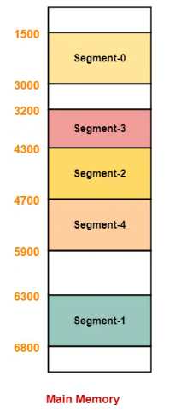

Slide 53
Paging Vs. Segmentation
S.N. | Paging | Segmentation
1 | Non-Contiguous memory allocation | Non-contiguous memory allocation
2 | Paging divides program into fixed size pages. | Segmentation divides program into variable size segments.
3 | OS is responsible | Compiler is responsible.
4 | Paging is faster than segmentation | Segmentation is slower than paging
5 | Paging is closer to Operating System | Segmentation is closer to User
6 | It suffers from internal fragmentation | It suffers from external fragmentation
7 | There is no external fragmentation | There is no internal fragmentation
8 | Logical address is divided into page number and page offset | Logical address is divided into segment number and segment offset
9 | Page table is used to maintain the page information. | Segment Table maintains the segment information
10 | Page table entry has the frame number and some flag bits to represent details about pages. | Segment table entry has the base address of the segment and some protection bits for the segments.

